Slide 1
Chapter 4
Number Theory

Slide 2

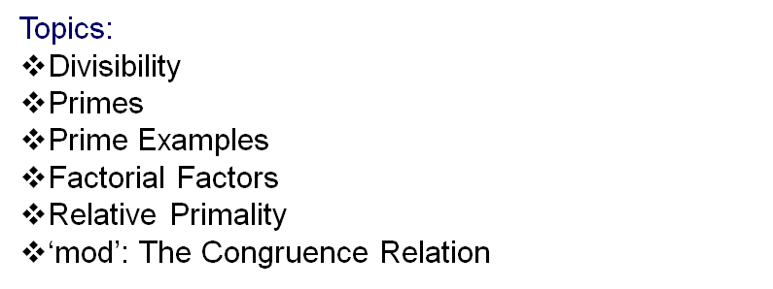

Slide 3
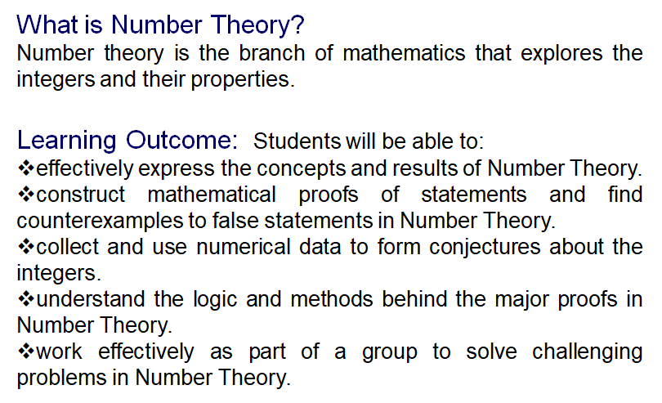
Number Theory

Slide 4
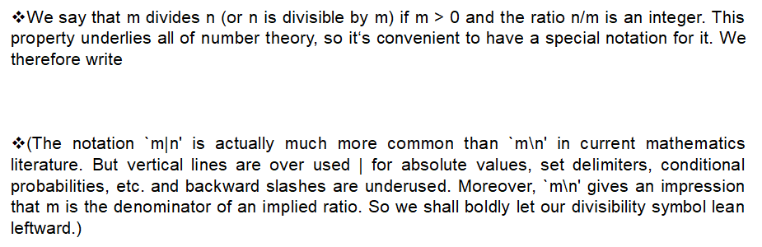
Divisibility

Slide 5



GCD & LCM

Slide 6
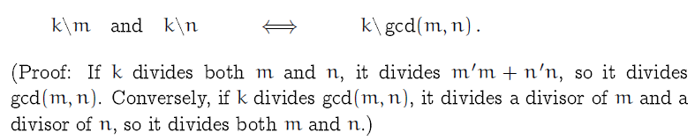
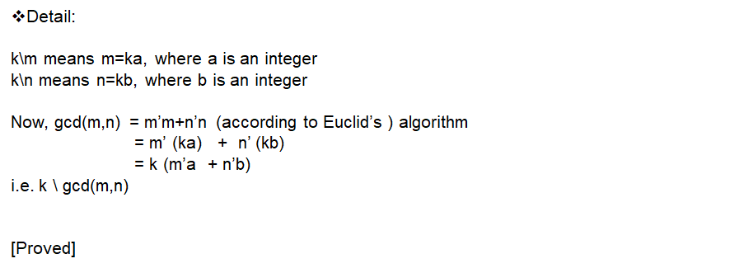
Proof 1

Slide 7

Primes

Slide 8
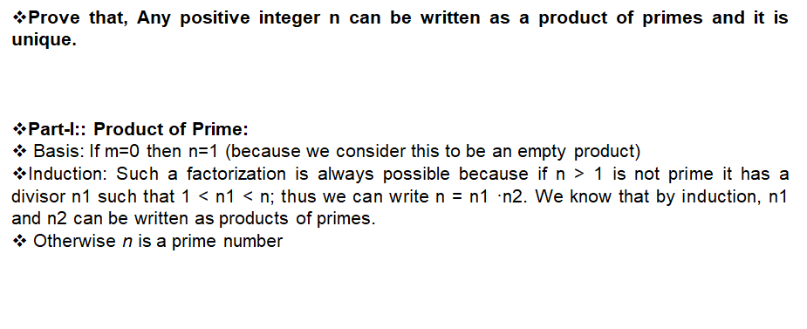

Proof 2

Slide 9
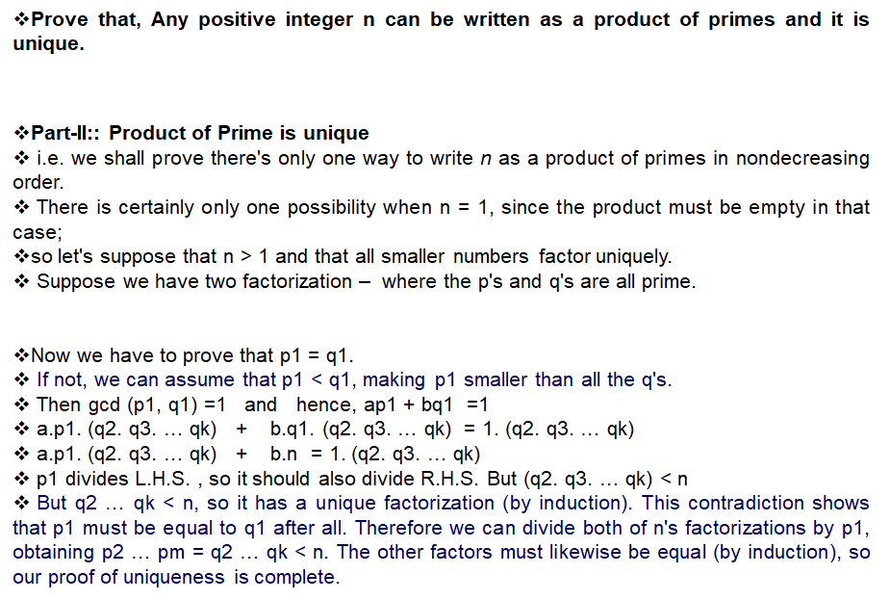

Proof 2 (Contd)

Slide 10
Factorial Factors
See pdf given in your google classroom

